Slide 1

Motor Renewal
Resources
Repo: Link
Submission file: Link

Slide 2
[For Technical Team] Process Flow High level look into the flow and interaction of various modules
Steps
Remarks
Exploratory data analysis part 1
Understanding of available features in data.
Checking for data discrepancies: missing values and erroneous values.
Re-encoding data types.
For a detailed look do refer to the notebook:
- Exploratory data analysis part 2
- ETL for training data
Correlation analysis
Analysing pair-wise relationship between features with target variable.
Creating pipeline to prepare data for model training. In production this step would probably be done on SQL.
For a detailed look do refer to the notebook:
Feature engineering for training data and test data.
Reduce level of cardinality in features that have many levels.
Re-encoding binary variables.
One-hot encode categorical variables.
Splitting into train (80%) and test (20%) data.
Model training and in-sample/out-sample evaluation.
Train a gradient boosting classifier.
Evaluating performance of model on in-sample data and out-sample data using metrics that are not sensitive to class imbalance (precision, recall, ROC AUC).
More detailed EDA can be found in the working notebook: Link
2

Slide 3
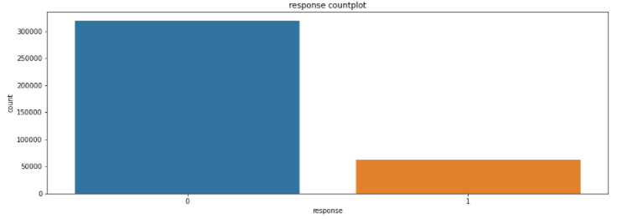
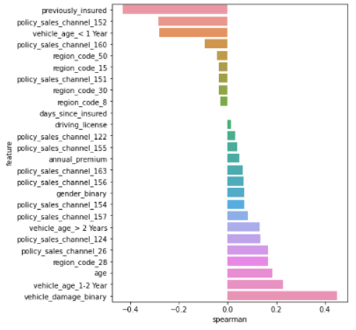
[For Technical Team] EDA High level understanding of data
Response Countplot:
Data is relatively imbalanced – will need to perform oversampling for particular models (linear models, SVMs, etc).
Use gradient boosted methods to help overcome this problem.
Correlation Plot:
Two categorical variables have been identified to be of high cardinality, policy_sales_channel and region_code.
Before running the full correlation analysis (diagram on the left), group classes that have low correlation into one class “others”.
As expected, the retention of a customer depends highly on whether a customer was previously insured and if the vehicle took damage before.
One interesting point is the negative correlation of previously insured customers with responses, indicating that perhaps the customer may be dissatisfied with the suite of motor insurance packages/service in general.
3

Slide 4
[For Technical Team] Results Performance metric and observations based on model performance
In-sample and Out-sample sets are obtained from the “train.csv” dataset – the “test.csv” dataset does not have the target variable hence this comparison cannot be made.
Model Choice:
Used a gradient boosted classifier to predict customer responses:
Tree based models are not overly impacted by the outliers in the data as the data is split using scores which are calculated using the homogeneity of resultant data points.
No feature scaling required as ensemble methods are not sensitive to variance in data.
Noted however that for other models (linear, SVM, etc) normalization would need to be performed.
In-Sample Performance
(Accuracy)
87%
Out-Sample Performance
(Accuracy)
84%
In-Sample Performance
(Precision)
67%
Out-Sample Performance
(Precision)
54%
Performance Remarks:
Taking note that the data is relatively imbalanced, the model performs relatively poorly on both the training and test data sets. For example, looking at precision, only 67% of positive responses predicted are in fact true positive predictions for the in-sample data. This number drops to 54% for the out-sample data.
This possibly indicates the model’s high bias and variance problem, unable to generalize to both the in-sample and out-sample data.
How to improve performance:
Get more training data as well as more features such as claims records and various underwriting loading/discount factors.
Perform hyperparameter tuning on the GBM.
In-Sample Performance
(Recall)
50%
Out-Sample Performance
(Recall)
39%
In-Sample Performance
(ROC-AUC)
93%
Out-Sample Performance
(ROC-AUC)
89%
Top 5 feature importance:
Previous vehicle damage, Previously insured, Driver age, Sales channel, Vehicle Age
Notes:
Districts/Completion year with the largest errors

Slide 5
[For Business Team] Results Comparing between benchmark underwriting (rules based) practices vs model predictions
SIMULATED UNDERWRITING PRACTICE
PREDICTIVE MODEL PREDICTIONS
Ability to predict if a customer is going to retain
1%
Ability to predict if a customer is going to retain
40%
Method:
Renewal depends on customer’s claims experience and/or customer loyalty (how long a customer has been with Income). Assume no loading factors or good claims discount.
Renew if no previous vehicle damage or have previous vehicle damage but is previously insured.
Method:
Use predictive model to determine best variables that affect the customer’s propensity to retain their policy.
Key variables:
Previously insured
Duration of policy with Income
Previous vehicle damage
Key Variables (Top 5):
Previous vehicle damage
Previously insured
Driver age
Sales channel
Vehicle Age
Notes:
Districts/Completion year with the largest errors

